Slide 1



SuperStore Power BI
View in Power BI
Last data refresh:
1/20/2021 12:38:20 PM Central Asia Standard Time
Downloaded at:
1/20/2021 1:23:50 PM Central Asia Standard Time

Slide 2
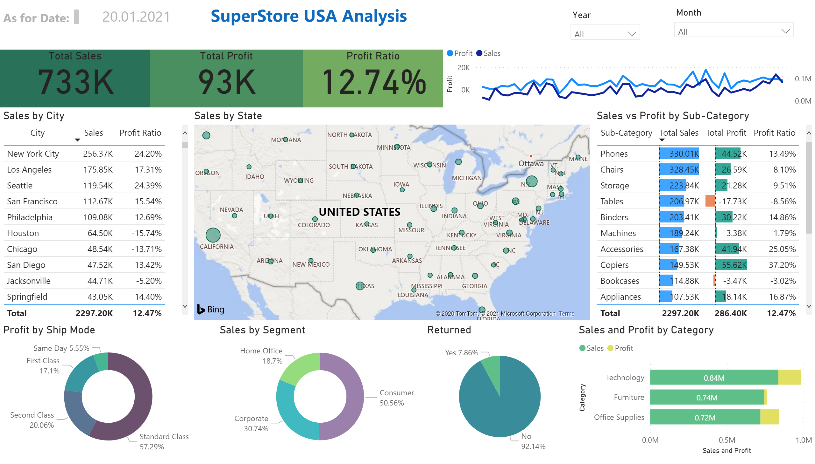
Page 1
Notes:
textbox
No alt text provided.
Total Sales
No alt text provided.
Total Profit
No alt text provided.
Profit Ratio
No alt text provided.
slicer
No alt text provided.
slicer
No alt text provided.
textbox
No alt text provided.
Sales by City
No alt text provided.
map
No alt text provided.
donutChart
No alt text provided.
donutChart
No alt text provided.
Sales vs Profit by Sub-Category
No alt text provided.
lineChart
No alt text provided.
barChart
No alt text provided.
Returned
No alt text provided.
card
No alt text provided.

